Slide 1
Bootstrap Typography
廖向德

Slide 2
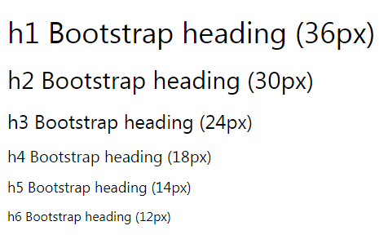
<h1> - <h6>
By default, Bootstrap will style the HTML headings (<h1> to <h6>) in the following way:

Slide 3
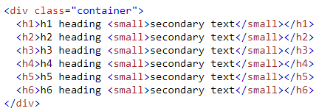
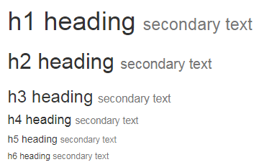

<small> or .small
use the <small> tag or <span> tag with .small class to display the secondary text of any heading in a smaller and lighter variation.

Slide 4
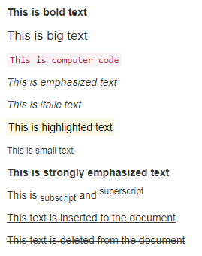
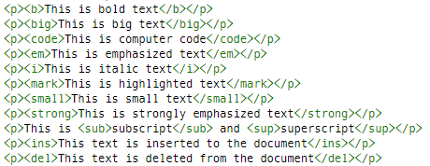
Text Formatting

Slide 5

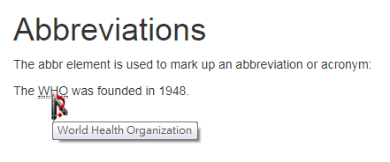
<abbr> for Abbreviations

Slide 6


<kbd>

Slide 7
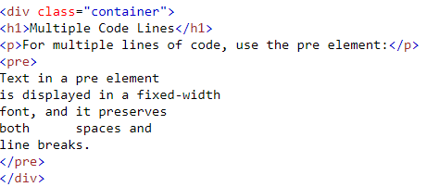

<pre>

Slide 8


Blockquote

Slide 9


Blockquote - reverse

Slide 10


Text Transformation Classes

Slide 11

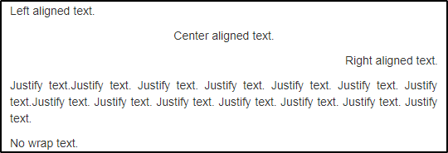
Text Alignment

Slide 12


Contextual Colors

Slide 13


Contextual Backgrounds

